Slide 1
Design Pattern Builder – Creational
Yudha Putra Arisandy

Slide 2
Outline
Definition of design pattern in general
Definition of Builder Design Pattern
apa yg perlu dideclare (class diagram)
Use case
(snippet of code - before and after using DP)
Cons of the design pattern
References

Slide 3
Definition of Design Pattern
high-level concepts.
Are reusable solutions to commonly occurring problems in software design.
Represent best practices and provide a template or blueprint for structuring code to solve particular design problems in a consistent and efficient manner.
Help developers communicate more effectively
by providing a common language to discuss and understand design concepts.
Promote code reusability, maintainability, and scalability.

Slide 4
Definition of Design Pattern (2)
Categories:
Creational Patterns: These patterns deal with object creation mechanisms, abstracting the instantiation process. Examples include Singleton, Factory Method, Abstract Factory, Builder, Prototype, etc.
Structural Patterns: Structural patterns focus on how classes and objects are composed to form larger structures. Examples include Adapter, Bridge, Composite, Decorator, Facade, Proxy, etc.
Behavioral Patterns: Behavioral patterns are concerned with algorithms and the assignment of responsibilities between objects. Examples include Observer, Strategy, Command, Iterator, Visitor, Chain of Responsibility, State, Memento, etc.

Slide 5
Definition of Design Pattern (2)
Creational patterns
are a type of software design pattern that deal with the instantiation process of creating objects in a software application.
Provide a structure for creating objects in an efficient and reusable manner.
The goal: To ensure that the process of creating objects is easy to maintain and extend in the future.
Divided into two main categories:
Single step object creation
Ex: Factory Method and Singleton patterns
Multi steps object creation
Builder and Prototype patterns.

Slide 6
Definition of Builder Design Pattern
Builder is a creational design pattern that lets you construct complex objects step by step.
The pattern allows you to produce different types and representations of an object using the same construction code.
Flexibility
Reuse of existing code

Slide 7
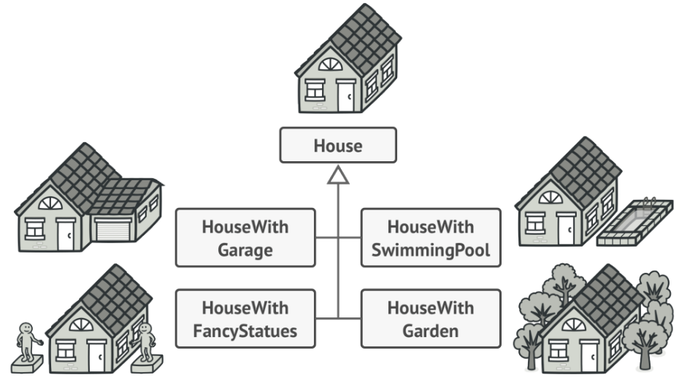
Definition of Builder Design Pattern
How to create the code:
Create many subclasses with additional properties.
Create only one class “House” with a lot of parameters in Constructor.
You might make the program too complex by creating a subclass for every possible configuration of an object.

Slide 8
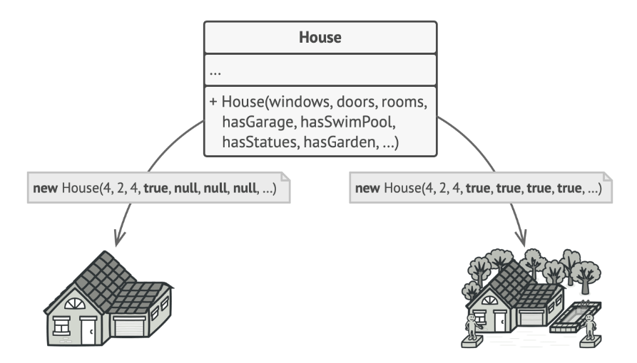
Definition of Builder Design Pattern
How to create the code:
Create many subclasses with additional properties.
Create only one class “House” with a lot of parameters in Constructor.
The constructor with lots of parameters has its downside: not all the parameters are needed at all times.

Slide 9
Function of Builder Design Pattern
Function:
The function of Builder is to provide flexible solution to various object creation problems in OOP. It separates construction of complex object from it representation, so same construction process can create different representation.
Builder builds complex object using simple object.
The reason builder needed:

Slide 10
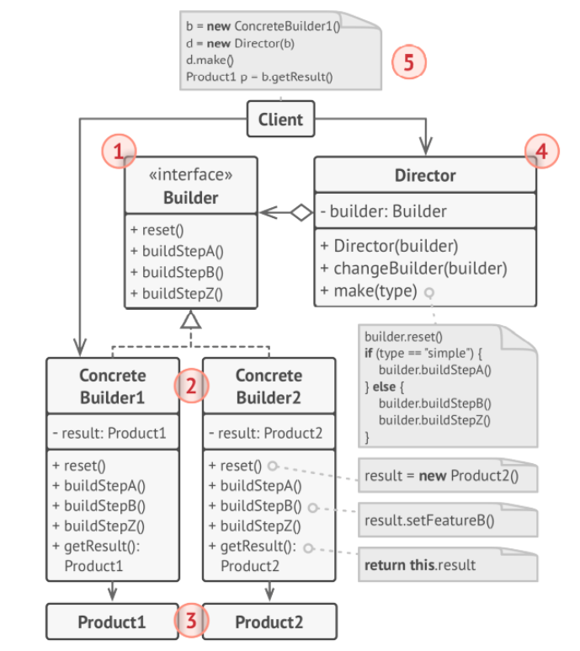
Creating Builder Design Pattern
Builder interface declares product construction steps
Concrete Builder provide different implementation
Products is result of object
Director defines the order in which to call construction steps, so you can create and reuse specific configurations
Client must associate one of the builder objects with the director

Slide 11
Creating Builder Design Pattern (2)
Before implementing Builder:
class Program { static void Main(string[] args) { var hamSandwichBuilder = new HamSandwichBuilder(); var sandwichMaker = new SandwichMaker(hamSandwichBuilder); sandwichMaker.MakeSandwich(); var sandwich = hamSandwichBuilder.GetSandwich(); sandwich.Display(); } } // Product class public class Sandwich { public string Bread { get; set; } public string Meat { get; set; } public List<string> Toppings { get; set; } = new List<string>(); public void Display() { Console.WriteLine($"Bread: {Bread}"); Console.WriteLine($"Meat: {Meat}"); Console.WriteLine("Toppings:"); foreach (string topping in Toppings) { Console.WriteLine($"- {topping}"); } } } // Builder interface public interface ISandwichBuilder { void AddBread(string bread); void AddMeat(string meat); void AddTopping(string topping); Sandwich GetSandwich(); }
// Concrete builder public class HamSandwichBuilder : ISandwichBuilder { private Sandwich _sandwich = new Sandwich(); public void AddBread(string bread) { _sandwich.Bread = bread; } public void AddMeat(string meat) { _sandwich.Meat = meat; } public void AddTopping(string topping) { _sandwich.Toppings.Add(topping); } public Sandwich GetSandwich() { return _sandwich; } } // Director class public class SandwichMaker { private readonly ISandwichBuilder _builder; public SandwichMaker(ISandwichBuilder builder) { _builder = builder; } public void MakeSandwich() { _builder.AddBread("Wheat"); _builder.AddMeat("Ham"); _builder.AddTopping("Lettuce"); _builder.AddTopping("Tomato"); _builder.AddTopping("Mayonnaise"); } }

Slide 12
Creating Builder Design Pattern (2)
After implementing Builder:
class Program { static void Main(string[] args) { var hamSandwichBuilder = new HamSandwichBuilder(); var sandwichMaker = new SandwichMaker(hamSandwichBuilder); sandwichMaker.MakeSandwich(); var sandwich = hamSandwichBuilder.GetSandwich(); sandwich.Display(); } } // Product class public class Sandwich { public string Bread { get; set; } public string Meat { get; set; } public List<string> Toppings { get; set; } = new List<string>(); public void Display() { Console.WriteLine($"Bread: {Bread}"); Console.WriteLine($"Meat: {Meat}"); Console.WriteLine("Toppings:"); foreach (string topping in Toppings) { Console.WriteLine($"- {topping}"); } } } // Builder interface public interface ISandwichBuilder { void AddBread(string bread); void AddMeat(string meat); void AddTopping(string topping); Sandwich GetSandwich(); }
// Concrete builder public class HamSandwichBuilder : ISandwichBuilder { private Sandwich _sandwich = new Sandwich(); public void AddBread(string bread) { _sandwich.Bread = bread; } public void AddMeat(string meat) { _sandwich.Meat = meat; } public void AddTopping(string topping) { _sandwich.Toppings.Add(topping); } public Sandwich GetSandwich() { return _sandwich; } } // Director class public class SandwichMaker { private readonly ISandwichBuilder _builder; public SandwichMaker(ISandwichBuilder builder) { _builder = builder; } public void MakeSandwich() { _builder.AddBread("Wheat"); _builder.AddMeat("Ham"); _builder.AddTopping("Lettuce"); _builder.AddTopping("Tomato"); _builder.AddTopping("Mayonnaise"); } }

Slide 13
Creating Builder Design Pattern (3)
Conclusion of step by step :
Create an interface with methods that define the steps to create an object.
Create one or more classes that implement the interface.
Create a director class that uses the builder interface to create an object, but is unaware of the implementation details.
Use the director class to manage the construction process of the object.
Call the appropriate methods of the builder object in the director class to create the object.
When the object is fully constructed, call the appropriate method of the builder object to retrieve the object.

Slide 14
Pros and Cons of Builder Design Pattern
Pros:
Construct object step-by step
Reuse same construction code for building various representative product
Single Responsibility Principle
Cons:
Code become more complicated

Slide 15
References
Head First Design Patterns
Design Pattern : https://docs.google.com/document/d/1B79XMGp4a6nDDhRnx-fSKIkPrn11i7U_vumdkqNf0WU/edit
Creational Design Pattern : https://docs.google.com/document/d/1LSTLK4IR8glcU5tEZiKxf4tmxRXHMp0TCE8Z9kF8bkg/edit
C#3.0 Design Patterns - Judith Bishop
RefactoringGuru or Deep Dive into Design Patterns

